Slide 1
CS 418 - Final Project
By: Vignesh Narayanaswamy, Arianna Brown,
& Warisa Siewsrichol

Slide 2
Problem Statement
Our problem was predicting the probability that someone will experience financial distress in the next two years. We assessed the risk factors associated with low credit scores and found patterns that would help us predict financial distress.

Slide 3
Why
Would be useful to improving the already-existing credit score algorithms banks use to decide whether a loan should be granted.
To explore the attributes that play a major role in someone facing a financial distress.

Slide 4
Data Source
https://www.kaggle.com/c/GiveMeSomeCredit/data
Variables: Number of past due dates, Debt Ratio, Age, Monthly Income, Open Credit Cards, Loans etc
Size of Data set: 252,000 entries

Slide 5
Data Science Solution Description:
Preparing Data and Cleaning
Outlier Detection and Removal
Handling Skewed Data

Slide 6
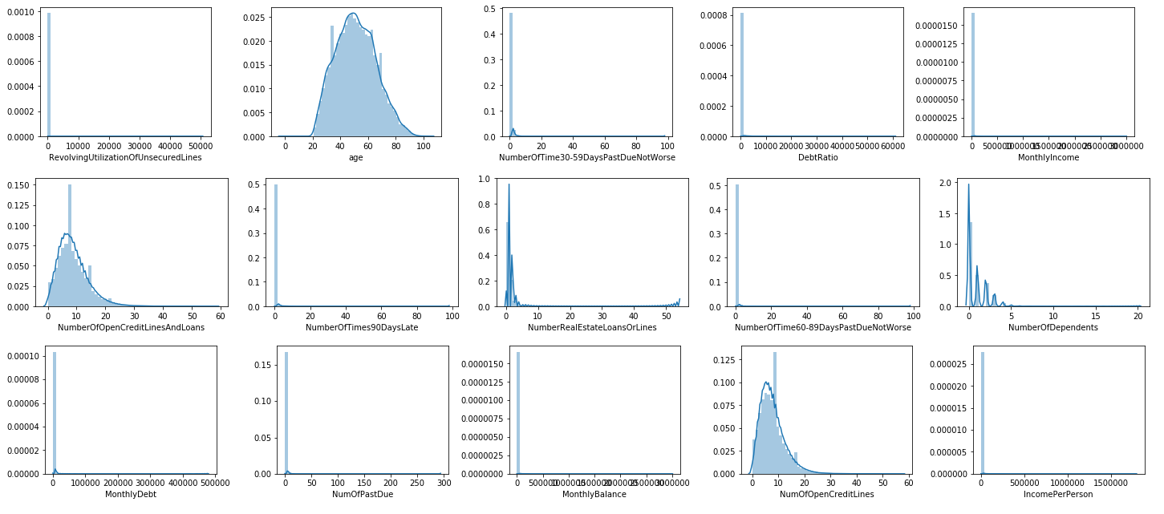
Before:

Slide 7
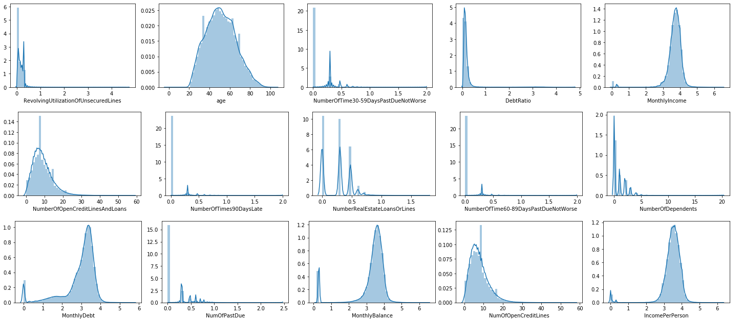
After

Slide 8
Data Science Solution Description:
Modeling
Classification: To predict a person would be under financial distress in the next 2 years.
Clustering: To find trends that can be noticed in customers that face a financial distress.

Slide 9
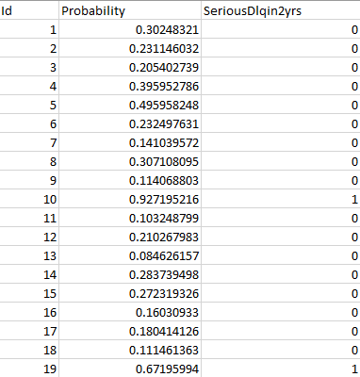
Classification Results
Interpretation
For the 10th and 19th observations, we see a high probability of financial distress and thus the truth value specified by SeriousDlqin2yrs is 1.

Slide 10
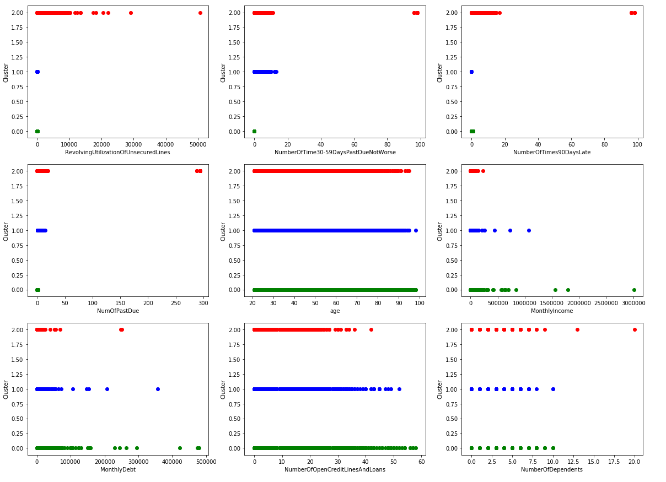
Clustering
Scatter Plots

Slide 11
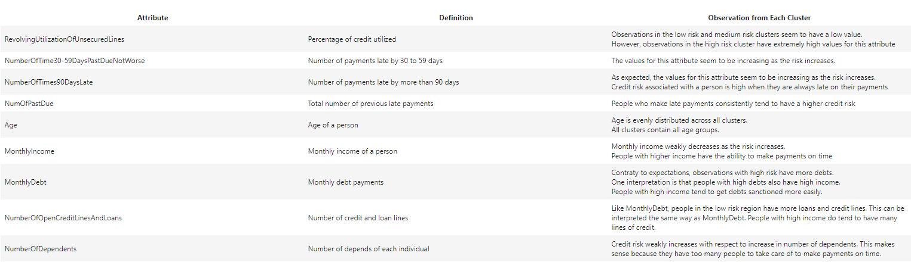
Clustering Results

Slide 12
Thank You

